Slide 1
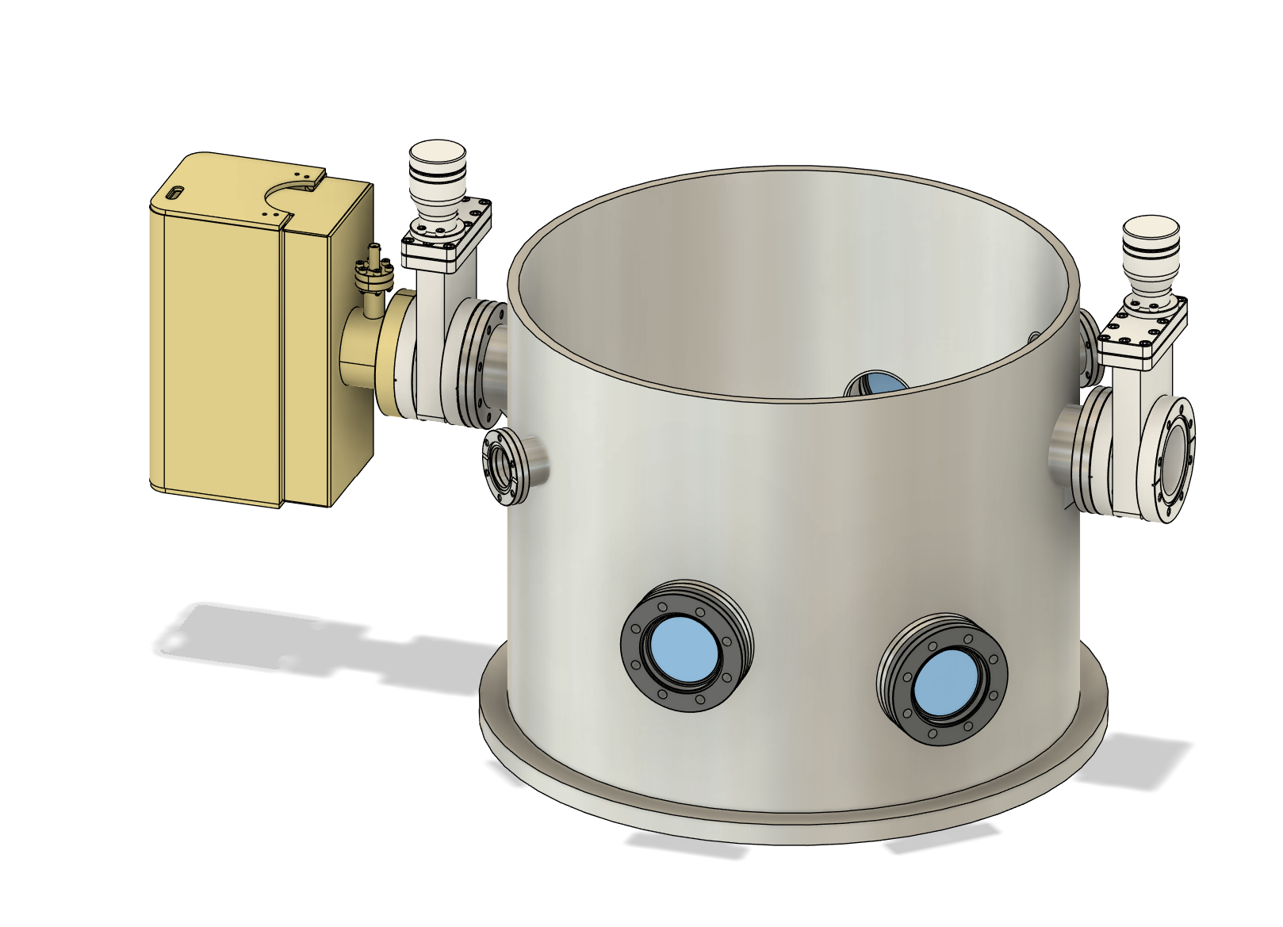
Vacuum Tank
The tank is going to cost around 15k (w/o tax)
Pfiffer and Lesker seem to have similar offers.
50 cm diameter, 50 cm height – about 100 L volume
4 additional flanges: for pumps (DN63 CF), venting and the gauge (DN40 CF)
Top plate would be ISO K 500 as it is easier to handle than a similar size CF.

Slide 2
The Pumps
Leybold Scroll pump
Leybold Turbo pump – 90 L/s
Gamma Vacuum Ion Pump – 75 L/s
20 kg, needs additional support

